Slide 1
SUDOKU SOLVER
C-mini project -Aayush Acharya (074BCT501) -Bibek Kaliraj(074BCT510) SUBMITTED TO: DEPARTMENT OF ELECTRONICS And COMPUTER ENGINEERING

Slide 2
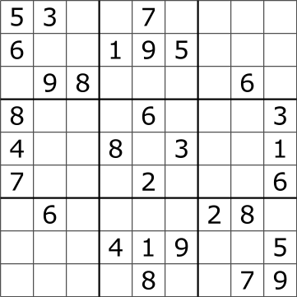
SUDOKU
Sudoku has a 9x9 grid divided into 9 3x3 grids.
Each cell has to be filled from numbers 1-9 such that a. Each row has different number. b. Each column has a different number. c. Each 3x3 box or grid has different number.

Slide 3
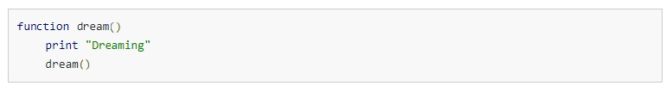
Recursion and backtracking
Recursion is when a function calls itself.
It is a very useful tool in solving problems of same kind.
A recursion must have terminating condition.
Those who have watched Inception can relate…
Notes:
Tell about stack overflow.

Slide 4
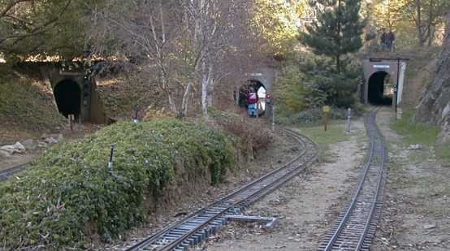
Continued..
Backtracking means to retrace one’s steps. ▪ It can be used by recursion or stack iteration.
It can be clearly understood by this ↓ example
Notes:
Gold and 3 tunnels

Slide 5
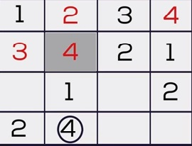
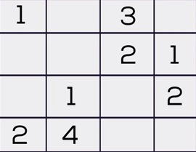
Solving Sudoku Using Backtracking
Let us consider a 4x4 Sudoku for argument’s sake.
First we check empty cells location in this 4x4 grid.
Then, we set a loop from 1-4, check whether there is conflict
If no conflict, assign it to matrix element and recursively fill the rest.
If for a particular cell no number from 1-4 are satisfied then backtrack and reassign value to previous cell
No number from 1-4 satisfies the condition in that cell.
An 4x4 Sudoku grid

Slide 6
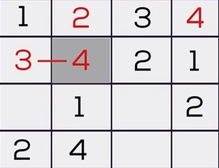
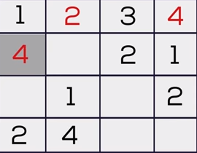
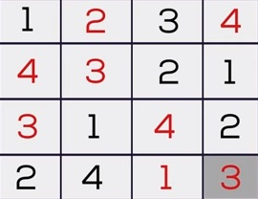
Since no condition satisfies it, we backtrack.
So we backtrack and number increases to 4
Similarly we fill the rest of the grid

Slide 7
Bbool solveSudoku(sudoku[9][9])
int row,col,num=1;
is any cell empty ?
N
return true;
Y
is (num<=9) ?
Is there any conflict?
Y
N
sudoku[row][col]=num
is (solveSudoku(sudoku)==true?
Y
return true;
N
sudoku[row][col]=EMPTY; num++
return false;
Fig: Flowchart

Slide 8
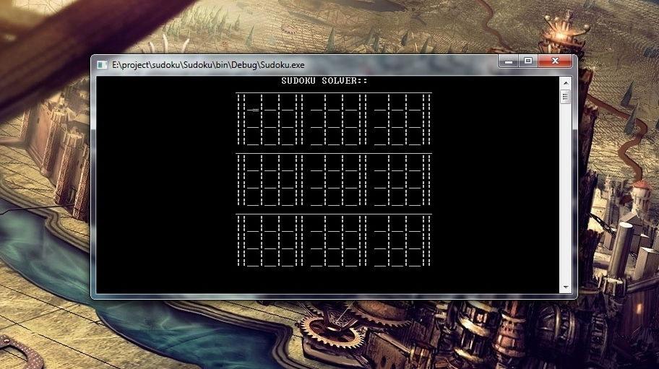
OUTPUT SNAPSHOTS

Slide 9
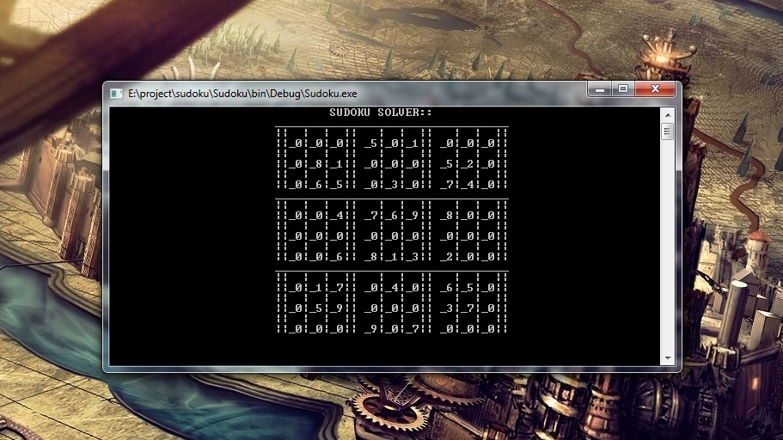
Filling the Sudoku Grid

Slide 10
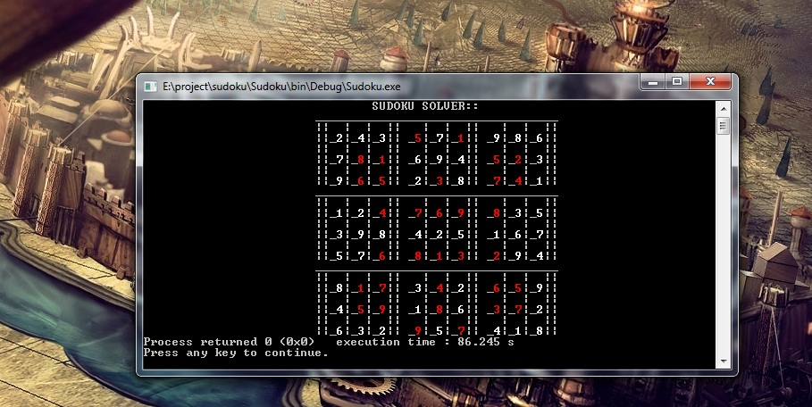
Solved Sudoku

Slide 11

ANY QUESTIONS ?

Slide 12


